Slide 1

Satellite Orbit Classification
Group 2: Premanshu Bhagat
Course: 4AI3 – Artificial Intelligence
Instructor: Alireza Fatehi

Slide 2

Outline
Scope & Motivation
Data Collection
Data Pre-Processing
Model Selection
Model Training
Model Evaluation
References

Slide 3

Scope
Classify satellites into respective orbits based on Orbital Parameters for the satellite.
Orbit Labels: LEO, MEO, GEO, Elliptical.
Relevant Orbital Parameters:
Inclination – angle between orbital plane(Satellite) and plane of reference (Earth)
Eccentricity – shape of orbit especially circularity of the orbit
Semi-Major Axis – half of the diameter of the orbital ellipse
Period – time taken to complete 1 revolution

Slide 4
Motivation
Though orbits are defined post launch, the rapidly increased cadence of satellite launches makes manual calculation cumbersome and error-prone.
By leveraging machine learning we can simply input parameters for a planned satellite orbit injection beforehand and thus define the orbit based on empirical data.
This would enable early-stage mission validation and feasibility thus improving operational efficiency.
This classification is crucial for:
Collision avoidance
Ground station scheduling and coherence
Regulatory compliance

Slide 5
Data Collection
Data Source: UCS Satellite Data Set
Author: UCS – Union of Concerned Scientists
Length: Over 7,560 operational satellites included in the database.
Features: 28 types of data for each satellite.
Relevant Parameters:
Inclination, Eccentricity, Period and Perigee/Apogee(used to calculate Semi-Major Axis)
Covers all major orbit types.
Alternate Source: same dataset available on Kaggle, but check for older versions, the UCS website updates the database consistently.

Slide 6
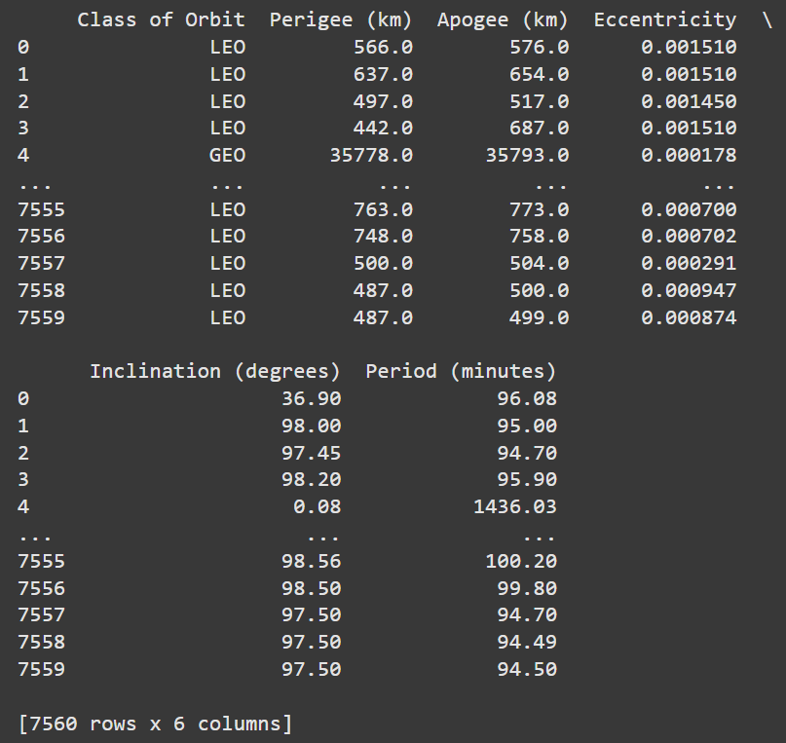
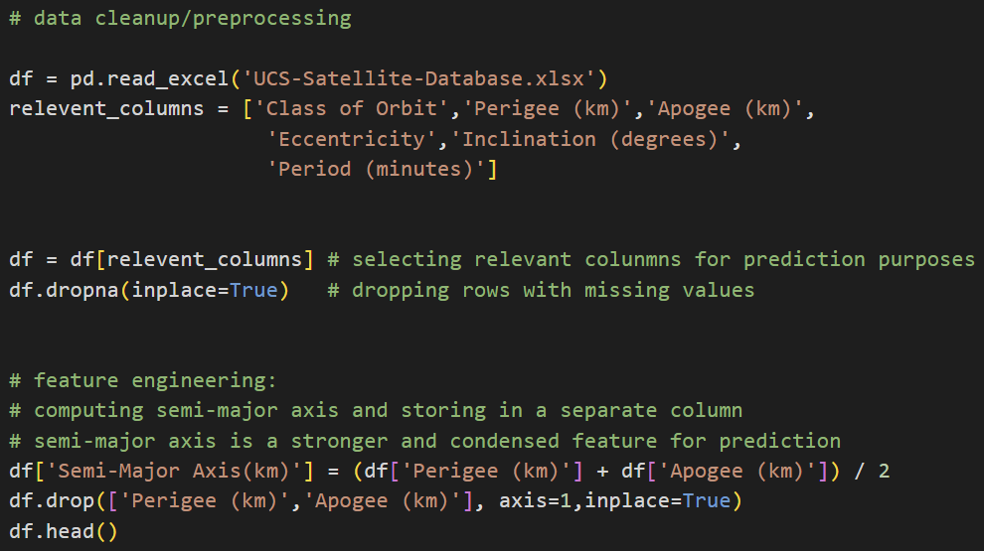
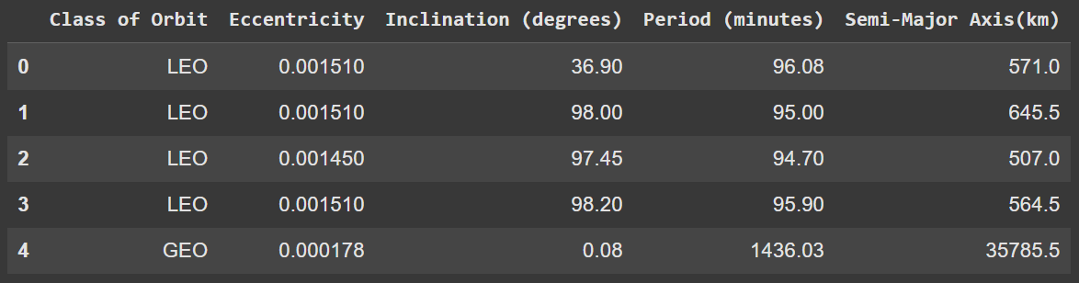
Data Preprocessing
Dropped missing values to ensure data quality.
Semi-Major axis calculation based on apogee and perigee values to ensure most relevant feature used and compact representation of the orbital size.
Standardization using the StandardScalar
Orbital class encoded numerically by using the LabelEncoder

Slide 7
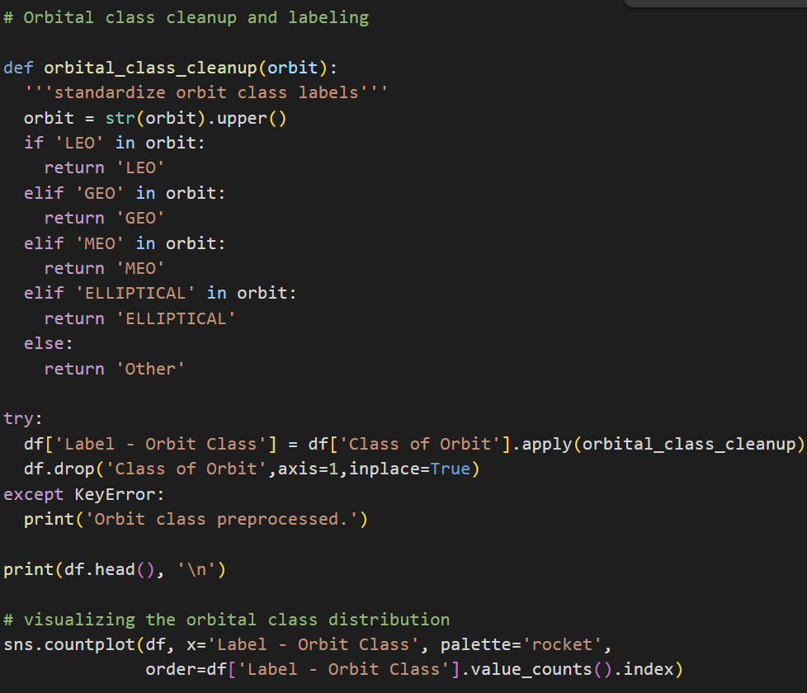
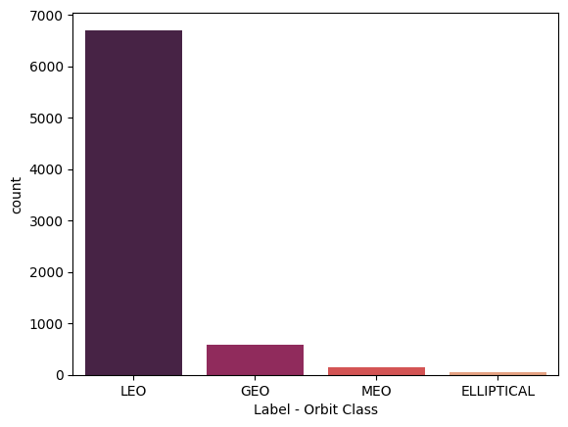
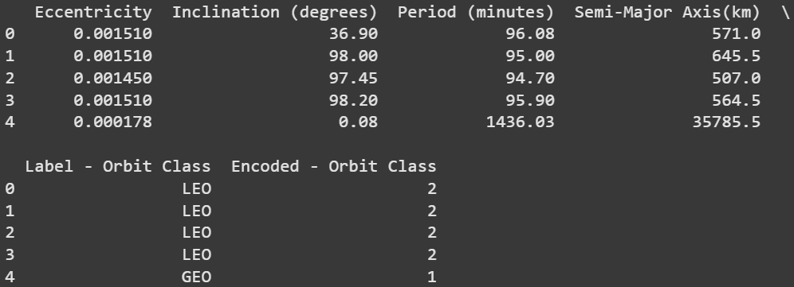
Data Preprocessing

Slide 8
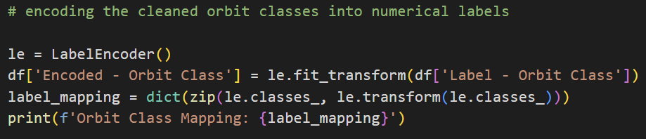
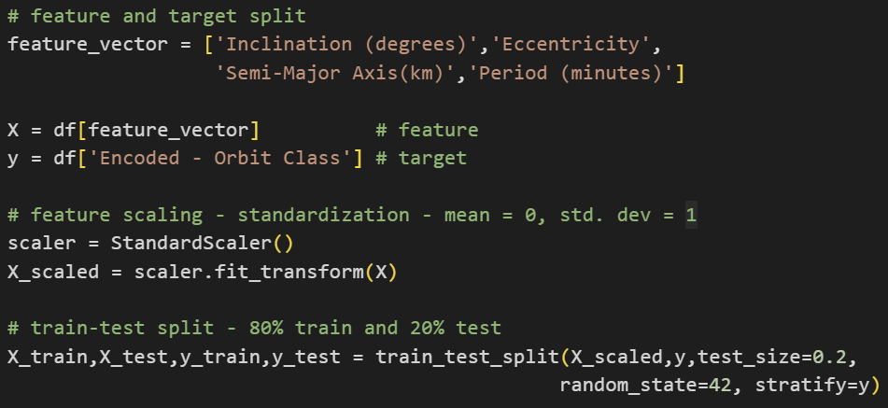
Data Preprocessing
Encoding cleaned orbit column using LabelEncoder() to map the target labels between 0 to 3
Orbit Class Mapping - 'ELLIPTICAL’: 0, 'GEO’: 1, 'LEO’: 2, 'MEO’: 3
Pretraining data split.
80-20 split between train and test data.

Slide 9
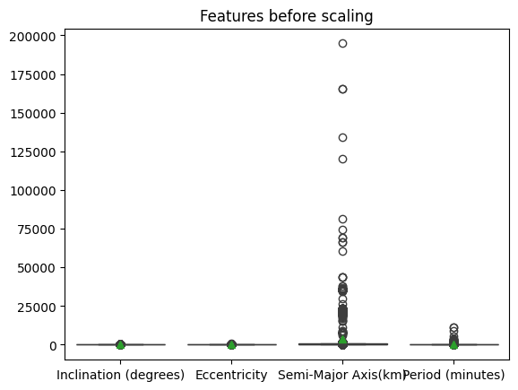
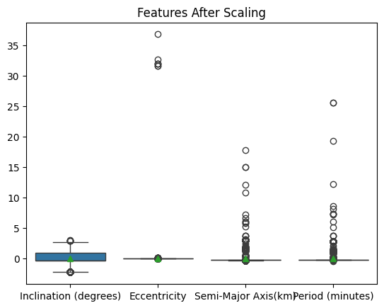
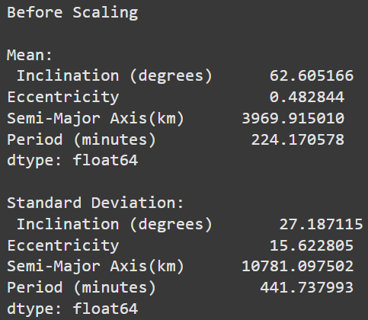
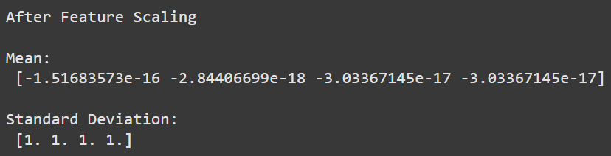
Data Preprocessing
Features BEFORE scaling
Features AFTER scaling

Slide 10
Model Selection
Decision Tree Classifier was the model of choice for the problem.
Reasons:
Problem type is multiclass classification and requires well defined regions for each class.
Recursive data splits till a stopping criterion reached thus ensuring optimal classification.
Each split based on trivial guidelines.
Good at handling non-linear decision boundaries as features usually have complex relations.
Feature scaling is done but not required to train a decision tree.
Scalable to more features, both numerical and categorical.
Fast training.

Slide 11
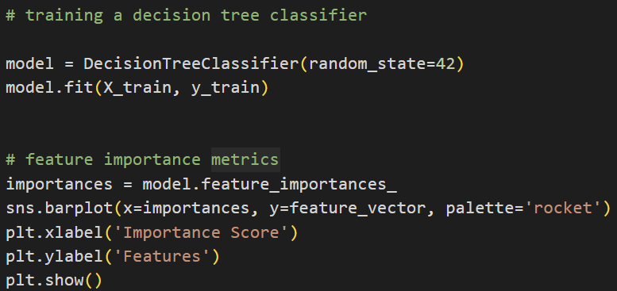
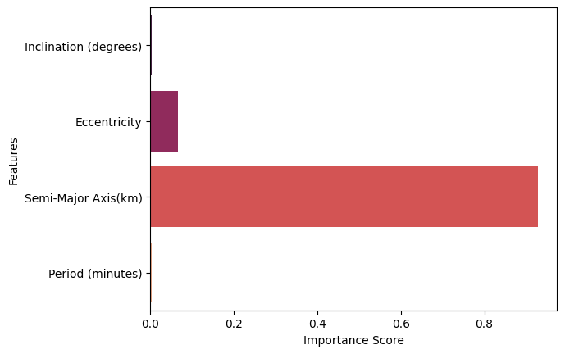
Model Training
All 4 features used for training the decision tree classifier.
Feature importance metrics generated to highlight the features that contribute the most to the decision boundary classification.
Semi-Major Axis(km) with an importance score of approximately 0.9 contributes the most to the decision process.
Eccentricity is the 2nd most important feature in the decision process followed by inclination and period being the least significant.

Slide 12
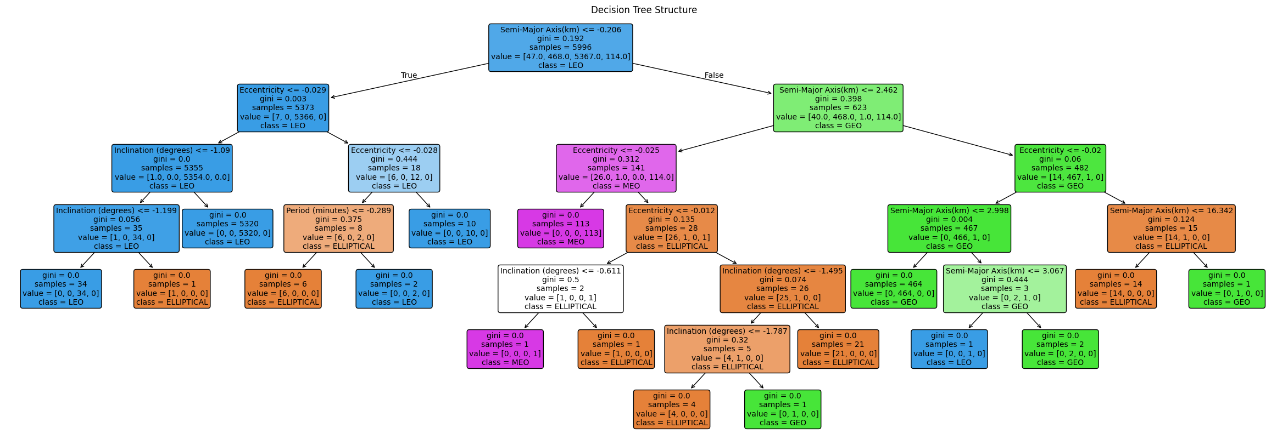
Model Training
For visualizing decision splits and boundary definition by the algorithm: use plot_tree from sklearn.tree
Gives a visual representation of the decision process implemented internally.

Slide 13
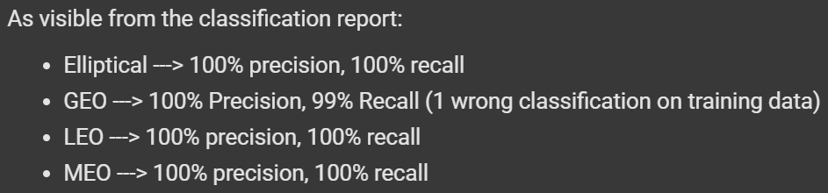
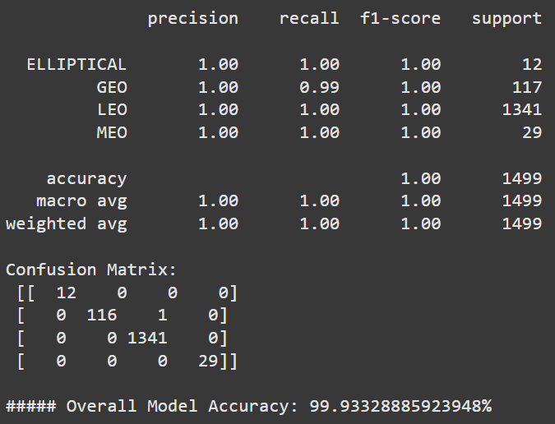
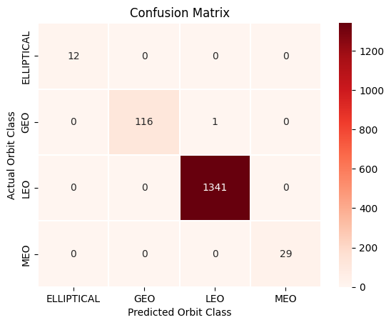
Model Evaluation - Metrics
Evaluated using precision, recall, f1-score & accuracy.
Overall Accuracy Achieved ~= 99.9%.
The f1 score indicates harmonic balance between precision and recall.

Slide 14
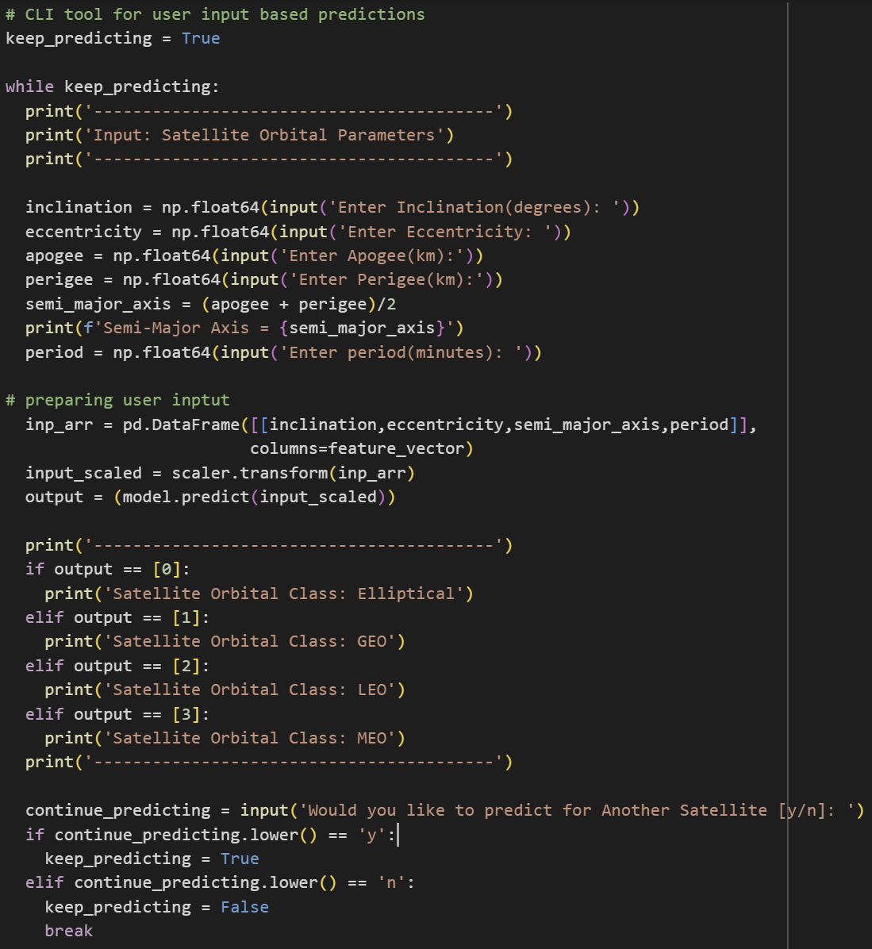
Model Evaluation – User Input Predictions
User input collection logic:
Collect parameters for predictions
Prepare input (scale)
Make Prediction
Predicted label converted to orbit name.

Slide 15
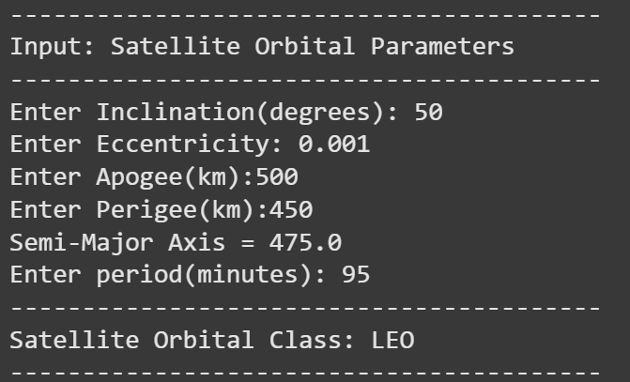
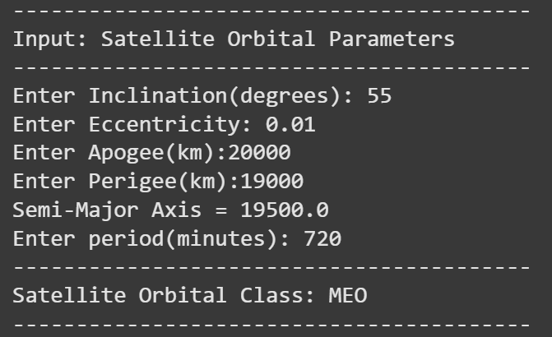
Model Evaluation – User Input Predictions

Slide 16
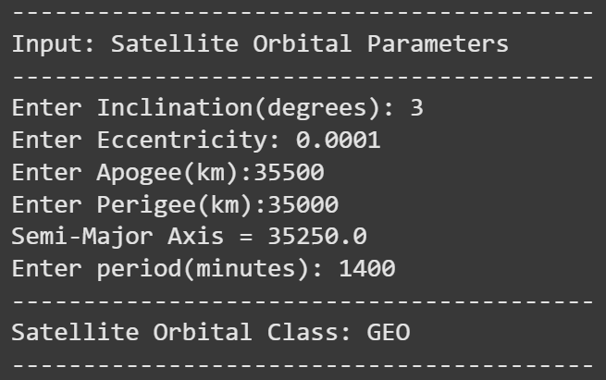
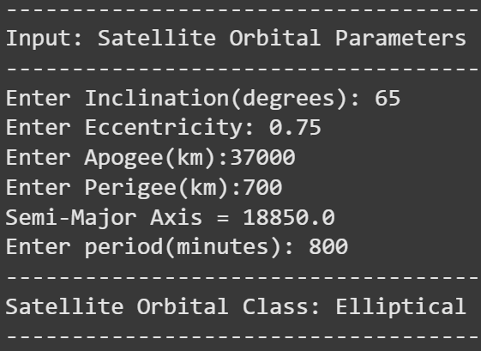
Model Evaluation – User Input Predictions

Slide 17

References
Documentation:
https://scikit-learn.org/stable/
https://numpy.org/
https://pandas.pydata.org/
https://seaborn.pydata.org/
https://scikit-learn.org/stable/modules/generated/sklearn.tree.DecisionTreeClassifier.html
https://docs.aws.amazon.com/wellarchitected/latest/machine-learning-lens/well-architected-machine-learning-lifecycle.html
UCS Data Set:
https://www.ucs.org/resources/satellite-database
Misc:
https://science.nasa.gov/learn/basics-of-space-flight/chapter5-1/#:~:text=Sun%20Synchronous%20Orbits,necessary%20to%20adjust%20the%20orbit.

Slide 18

Thank You

